Slide 1
RULES & REGULATIONS GUIDE
505 MAIN STREET
PINEVILLE, NORTH CAROLINA 28134
704-889-2291
WWW.PINEVILLENC.GOV

Slide 2
TABLE OF CONTENTS
About Pineville Social District…………………...………….3
What is a Social District?
District Boundaries…………………………………………………4
Map
Days and Hours of Operation…………….........…………..4
Participating and Non-Participating Locations.....5
Requirements
Social District Requirements……………………………………6
ABC Permittee Requirements………………………..……..6-7
Cup Requirements…………………………………….……………………7
Frequently Asked Questions………..…………………….8-9

Slide 3
ABOUT PINEVILLE SOCIAL DISTRICT
North Carolina Law on Social Districts
Pineville Social District allows people to sip beer, wine, or cocktails as they stroll through a defined area of Downtown Pineville. Social districts have been implemented in various towns and cities across the state since North Carolina General Assembly enacted legislation allowing municipalities to designate an area in which a person may consume alcoholic beverages sold by a licensed ABC permittee and taken outdoors.
https://www.ncleg.gov/Sessions/2021/Bills/House/PDF/H211v8.pdf
What is the purpose of a “Social District”?
A social district serves to increase economic activity and downtown walkability which will provide a natural exposure for our downtown businesses.

Slide 4
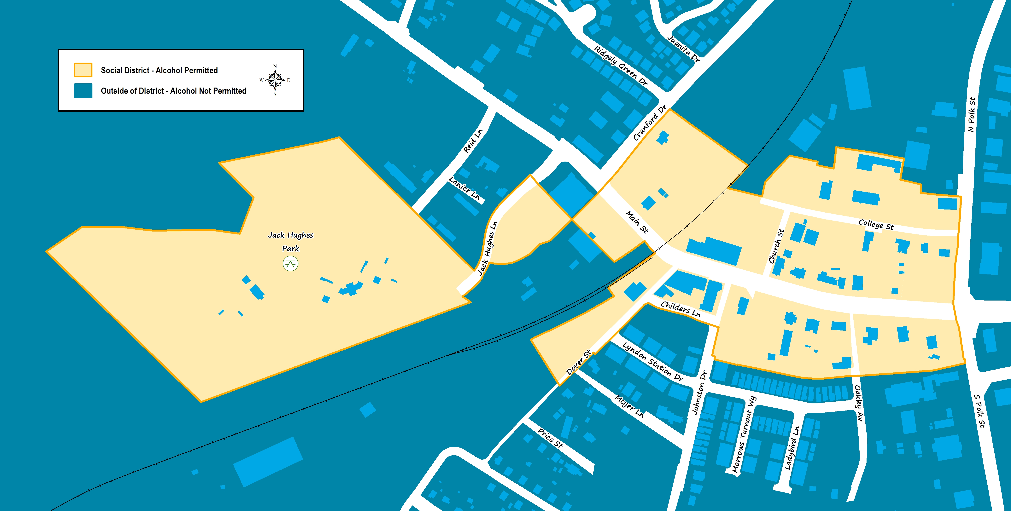
PINEVILLE SOCIAL DISTRICT MAP OF BOUNDARIES
Link to online map of the Pineville Social District [insert link]
Required signage will be located at several entry and exit points along the district border.
DAYS & HOURS OF OPERATION
SUNDAY | MONDAY | TUESDAY | WEDNESDAY | THURSDAY | FRIDAY | SATURDAY
1PM-10PM | 12PM-10PM | 12PM-10PM | 12PM- 10PM | 12PM-10PM | 12PM-10PM | 12PM-10PM
The social district operates 7 days a week.

Slide 5
PARTICIPATING &
NON-PARTICIPATING LOCATIONS
Businesses located within the social district boundaries can submit a participation form to identify whether they want to opt-in or opt-out of the district.
Window clings will be displayed on businesses entrance to identify their status:
SOLD HERE – for businesses with a licensed ABC permit authorized to sell and distribute alcohol
SOLD HERE & ALLOW: Business will serve alcohol and allow other social district beverages inside their establishment
SOLD HERE & NOT ALLOW: Business will serve alcohol and NOT allow other social district beverages inside their establishment
BEVERAGES WELCOME – for non-ABC permitted businesses that welcome alcoholic drinks in their establishments
PLEASE NO BEVERAGES – for businesses that do not want alcoholic beverages in their establishments
List of the Pineville Social District participating and non-participating businesses [insert link]. Business owners can change their participation status at any time.

Slide 6
PINEVILLE SOCIAL DISTRICT
OPERATIONS
The social district must meet the following requirements under North Carolina law…
Patrons must be 21 years of age or older and follow state and federal drinking laws.
Be purchased from a permittee located in the social district to be consumed in the social district.
Alcoholic beverages must only be served in designated social district cups with business name, date, and time.
Alcoholic beverages must be disposed of before exiting the social district unless entering a business within the social district that allows alcoholic beverages to be brought inside the business.
A single patron cannot be sold more than 2 alcoholic beverages at one time.
Civil Penalty: Any patron or business who violates the social district town ordinance may be fined by a civil penalty of $100.00.
Any ABC permittee, non-permittee or person who violates may be subject to its Social District Permit being revoked, suspended, or permanently banned from participating in the Pineville Social District.
Participation in the social district by a special event is at the discretion of the special event permit holder.
Pineville Police Department officials will patrol the downtown area including the Social District pursuant to its normal operations.
Pineville Police Dept Telephone #
Emergency 911
Non-Emergency 704-889-2231
Alcohol Law Enforcement (ALE) Telephone #
1-877-ALE-AGENT
Pineville Public Works Department will provide sanitation services within the district, including trash removal and litter pick up. Businesses are still responsible for maintaining sanitation on their property.

Slide 7
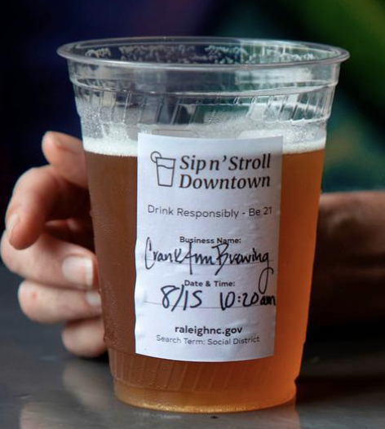
ABC PERMITTEE REQUIREMENTS
A permittee located and selling alcoholic beverages within the social district must meet the following requirements under North Carolina law…
The permittee must:
ABC permittees are required to comply with all ALE regulations and serve alcohol responsibly
Only sell and serve alcoholic beverages on its licensed premises.
Only sell and serve alcoholic beverages “to-go” during specified social district days and hours
Only sell alcoholic beverages for consumption in a container that meets all of the following requirements:
The container clearly displays Pineville Social District logo AND business name, time, and date.
The container shall be clear plastic only.
The container displays, in no less than 12-point font, the statement, "Drink Responsibly – Be 21."
The container shall not hold more than 16 fluid ounces.

Slide 8
FREQUENTLY ASKED QUESTIONS
What is a social district?
Social district is defined as areas where people can walk with open, to-go containers of alcoholic beverages in a contiguous area. A social district may include both indoor and outdoor areas of businesses within the defined district during the days and hours established for the social district.
When does the social district go into effect?
How will the social district boundaries be marked?
[Link to map of social district]
Signage and/or sidewalk decals will be clearly posted at entry and exit points of the social district.
Why does the social district end at 10pm?
10pm is consistent for when most of the downtown businesses close.
How does a business opt-in to the social district?
Businesses can submit this [insert link to participation form] to identify if they want to opt-in or opt-out of the social district.
What do I do if I am a retailer within the social district and do NOT want alcohol inside my business?
All businesses located within the social district have the option to opt-out of the district; you do NOT have to allow alcohol inside your business.
Door sign will be provided to every business to clearly indicate to patrons if the establishment is opt-in or opt-out of the social district.

Slide 9
FREQUENTLY ASKED QUESTIONS CONTINUED
What cups will be used for the social district? What is the cost to my business to use these cups?
16 oz, CLEAR, PET/ PETE (Polyethylene Terephthalate) are the preferred type of cup ABC-permittees will be required to obtain.
The Town of Pineville produced stickers that must be displayed on the cups. ABC-permittee establishments are required to indicate their business name, date and time the alcoholic beverage is served.
What are the requirements of a social district cup?
Container clearly identifies the ABC-permittee, date and time from which the alcoholic beverage was purchased.
Container clearly displays social district logo in which it will be consumed.
Container is NOT glass.
Container displays “Drink Responsibly-Be 21” in no less than 12-point font
The container is maximum of 16 fluid ounces.
Can I take an alcoholic beverage in my social district cup home with me?
No. Cups must be disposed of in a nearby recycling receptable prior to exiting the social district.
Alcoholic beverages must be purchased from an ABC-permittee located within the social district.
No personal beer, wine, or liquor can be brought into the social district.

Slide 10
FREQUENTLY ASKED QUESTIONS CONTINUED
Can I drink my own alcoholic beverage, pour it into a social district cup and walk around in the social district?
No. Only drinks purchased from qualified businesses within the social district are allowed.
No glass bottles, or outside drinks are permitted within the boundaries.
Are alcoholic beverages allowed inside Town Hall, Pineville Public Library, Pineville Communications, Pineville Public Works or Pineville Police Department?
No. Although these buildings are included in the social district boundaries, there are no alcoholic beverages allowed inside town government buildings.
Can I take an alcoholic beverage in my social district cup home with me?
No. Cups must be disposed of in a nearby recycling receptable prior to exiting the social district.
Alcoholic beverages must be purchased from an ABC-permittee located within the social district.
No personal beer, wine, or liquor can be brought into the social district.
Can a mobile pushcart sell alcoholic beverages as part of the social district?
No. Participating locations must be fixed permanent establishments with an ABC permit for on-site consumption.

Slide 11
FREQUENTLY ASKED QUESTIONS CONTINUED
Can a convenience store sell alcoholic beverages to-go as part of the social district?
No. Participating locations must be fixed permanent establishments with an ABC permit for on-site consumption.
Can I take my alcoholic beverage into a vehicle within the social district?
No. No person shall possess an alcoholic beverage while driving a vehicle, including bicycles, scooters and golf carts. An open container of any alcoholic beverage is prohibited in vehicles.
What happens if I leave the social district boundaries with an alcoholic beverage?
Individuals who leave the social district in possession of alcoholic beverages can be criminally charged by Pineville Police Department.
How will the social district be enforced?
Alcohol Law Enforcement (ALE) and Pineville Police Department have jurisdiction over the social district.
ABC-permittees compliance with ALE laws and serving responsibly.
How can I report when I see individuals breaking the regulations of the social district?
You can report violations to Pineville Police Department by calling their non-emergency telephone # 704-889-2231 or dial 911 in case of emergency

